Slide 1
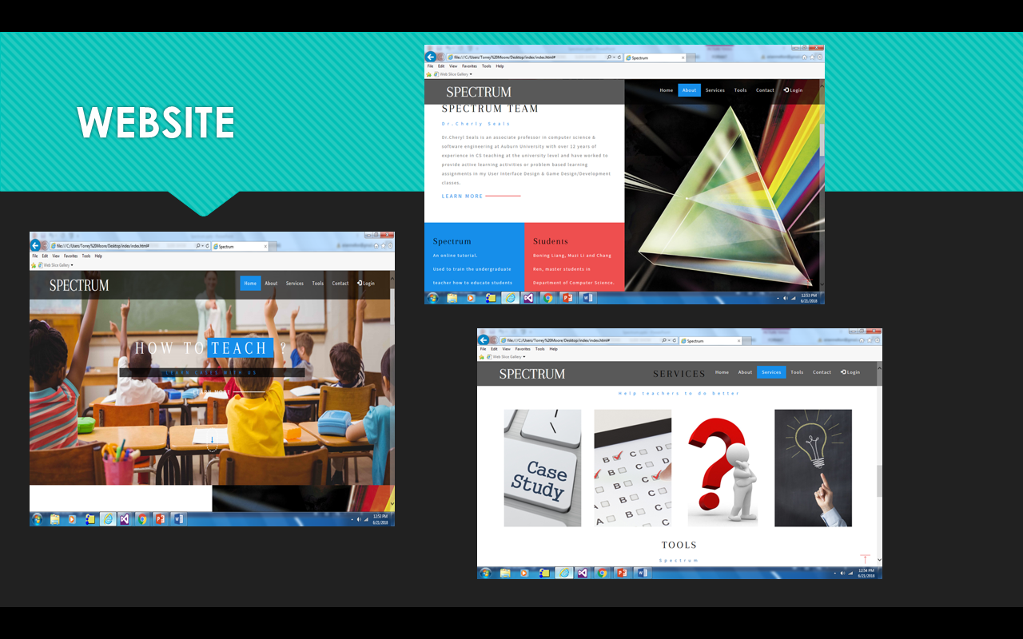
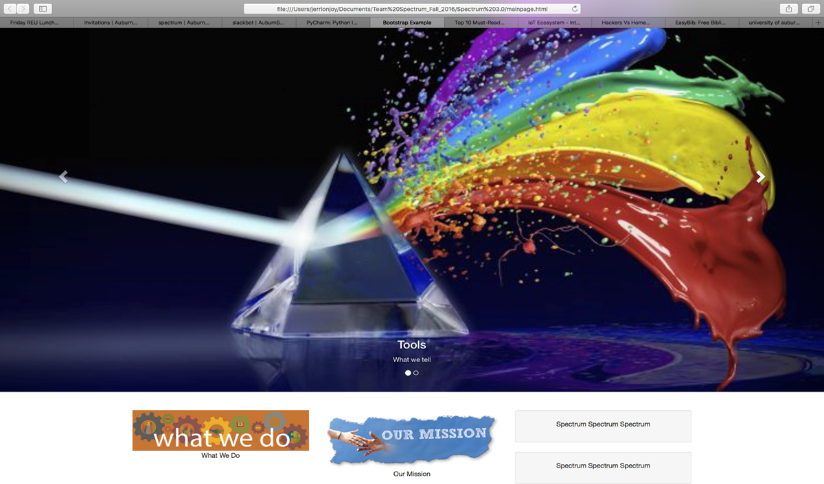
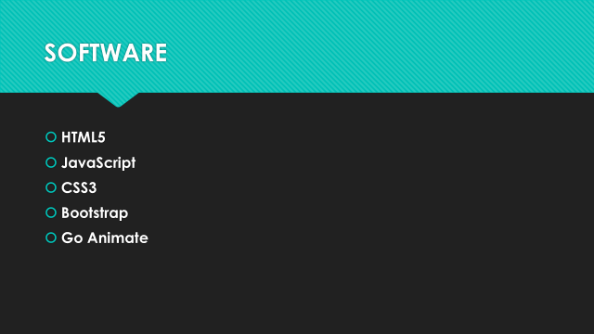
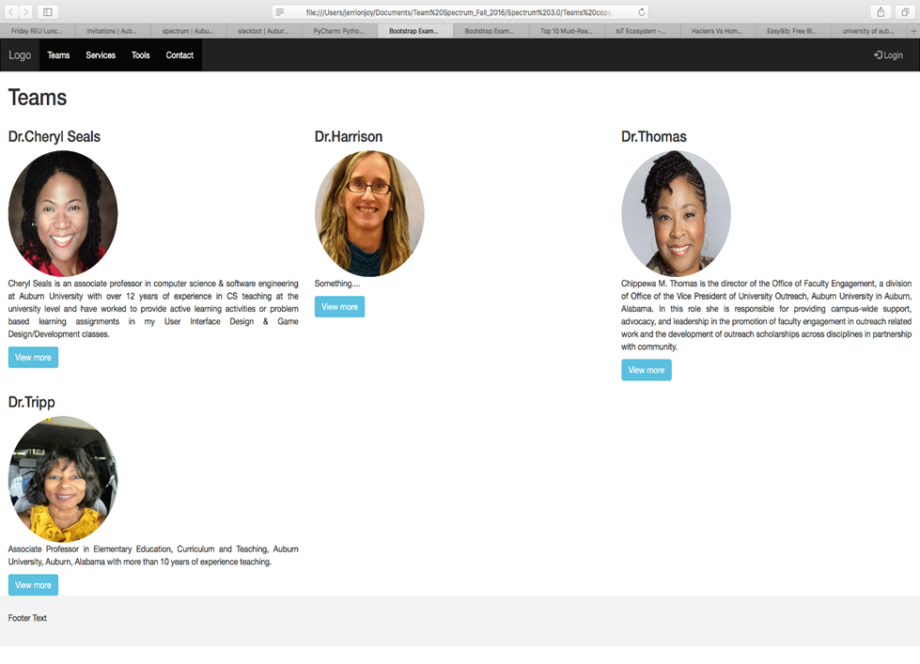
The Spectrum Project
Arian Williams, Koran Wright, Robertson Bassy, Destiny Charles, Ebbrea Wilson, Dr. Cheryl D. Seals
abstract
Problem Statement
design
There are innovations and creative things going on in animation world. Animation is one technology, which is used to show one’s creativity and even make the difficult concepts easily understandable to others. There are many software applications used for creating animation like Adobe Flash, GIF etc.
In this project, we create animated web tutorials to train undergraduate pre-service teachers’ in classroom management strategies with different kinds of students and situations. Our first step was to create the paper prototypes of the scenarios and based on these prototypes the animated tutorials are created. This project aims at creating Educational Teacher Training through Animated Case Studies. With Teacher training we have many teachers in colleges of education that teach classes on an individual basis how to address and react to classroom challenges. While creating the animated web tutorials, our main aim is to present a scenario which is simple, clear and easily understandable to the teachers and provide training to explore challenges in classroom management.
The Spectrum application is created with HTML5, CSS and PHP and animations are created in GoAnimate. A few years ago the customary practice was create animations and web tutorials with Macromedia Adobe Flash and Adobe Photoshop. Flash was a popular software previously used in creating web pages, animation, for creating advertisements, integration of videos into web pages and rich internet applications. Now a popular software to create web-based animations is GoAnimate and we utilized this software because of its ease of use and ability to create great animated scenarios.
There are many different methods of attempting to engage teachers to understand classroom environments and improve teaching capabilities. Technology holds a great potential for improving the quality of education for learners; however, if the created technology is not designed with a user-centric approach, it will inevitably fail to achieve the desired effect. It is hard to gauge a learner’s comfort level and ability to navigate and comprehend technology, which is generally directed correlated to the environment in which they grew up and what they are comfortable with. Information technology can be utilized to aid educators if the tools are user-friendly and have a great ease of use. If tools are well designed and usable, instructors will be able to use them to engage and captivate students.
Many of the present methods available for instructing pre-service teachers are not as effective as they should be. Various data has shown that visual case studies are an important measure in improving the effectiveness of training (Boling, 2007). Animated Web tutorials are a form of visual education tools. Animation can showcase one’s creativity and makes even the toughest concepts easier to comprehend. Our aim is that by incorporating animation into the existing textual case studies, teachers would be able to grasp concepts much more effectively. It will allow them to practically visualize the classroom environment and get a feel of the situation. The major advantage of developing online educational simulations is that they can be accessed anytime and anyplace where Internet access is supported. Many of the currently available tools are created in flash, which in many cases is outdated technology as it is not supported by many handheld devices. Interactive case studies also provide support for critical thinking and reflection skills, then a static video of an example case. The purpose of this study was to develop a low-cost educator friendly, web and mobile-oriented learning environment centered on ease of use and interactive technology for the educator so that the users can gain access to the educational content anytime and- anyplace.
A case has three sections
Scenario
Video
Reflection and Discussion
APPLICATion
Website
Development
CONCLUSIONS & Future work
+ Easy Navigation; Simple Design
Colors; Some disliked animations
Connect the webpages to a live server.
Add more scenarios
Run the website continuously without any major flaws.
Continuously make improvements for users.
User Testing

